Slide 1
Deep Learning
慈濟大學 醫學資訊系
林紋正
部分內容取自台大李宏毅老師

Slide 2
Introduction
Model high-level abstractions in data
  Learning representations of data
    E.g., image
      Low level: pixel
      Higher level: edges, regions of particular shape
Use complex structures
Non-linear
Can replacing handcrafted features with efficient algorithms for feature extraction
  Learn representations from large-scale unlabeled data

Slide 3
Deep Learning
Use a cascade of many layers of nonlinear processing units for feature extraction and transformation.
Based on the (unsupervised) learning of multiple levels of features or representations of the data.
  Higher level features are derived from lower level features to form a hierarchical representation.
  learn multiple levels of representations that correspond to different levels of abstraction; the levels form a hierarchy of concepts.

Slide 4
What is Deep?
The transformation from input to output is deep - lengthy
Many layers
  > 2 nonlinear layers

Slide 5
Deeper is Better?
Layer X Size | Word Error Rate (%) | Layer X Size | Word Error Rate (%)
1 X 2k | 24.2
2 X 2k | 20.4
3 X 2k | 18.4
4 X 2k | 17.8
5 X 2k | 17.2 | 1 X 3772 | 22.5
7 X 2k | 17.1 | 1 X 4634 | 22.6
 |  | 1 X 16k | 22.1
Not surprised, more parameters, better performance
Seide, Frank, Gang Li, and Dong Yu. "Conversational Speech Transcription Using Context-Dependent Deep Neural Networks." Interspeech. 2011.
Notes:
SWB
For a fixed number of parameters, a deep model is clearly better than the shallow one.

Slide 6
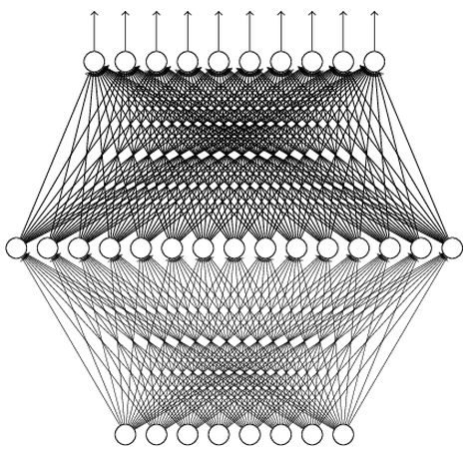
Universality Theorem
Any continuous function f
Can be realized by a network with one hidden layer
(given enough hidden neurons)
Reference for the reason: http://neuralnetworksanddeeplearning.com/chap4.html
Why “Deep” neural network not “Fat” neural network?
(next lecture)

Slide 7
Fat + Short v.s. Thin + Tall
The same number of parameters
Which one is better?
……
……
……
Shallow
Deep

Slide 8
Fat + Short v.s. Thin + Tall
Layer X Size | Word Error Rate (%) | Layer X Size | Word Error Rate (%)
1 X 2k | 24.2
2 X 2k | 20.4
3 X 2k | 18.4
4 X 2k | 17.8
5 X 2k | 17.2 | 1 X 3772 | 22.5
7 X 2k | 17.1 | 1 X 4634 | 22.6
 |  | 1 X 16k | 22.1
Why?
Seide, Frank, Gang Li, and Dong Yu. "Conversational Speech Transcription Using Context-Dependent Deep Neural Networks." Interspeech. 2011.

Slide 9
Compositionality
Assumption: the data we are observing came up by composition of pieces.
Distributed Representations
  The features are individually meaningful
  Most features are learned independent of each other
  Can learn a very complicated with a low number of examples

Slide 10
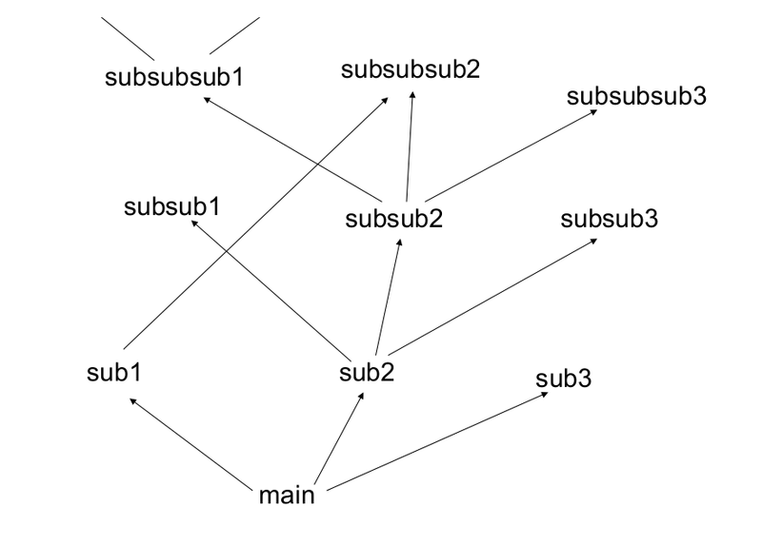
Compositionality
Deep → Modularization
Don’t put everything in your main function.
Reused subroutines
Deep neural network is more cheaply, ie., with less number of hidden units.
http://rinuboney.github.io/2015/10/18/theoretical-motivations-deep-learning.html

Slide 11
Learning Representation – Autoencoder
Output = input
Learning by backpropagation

Slide 12
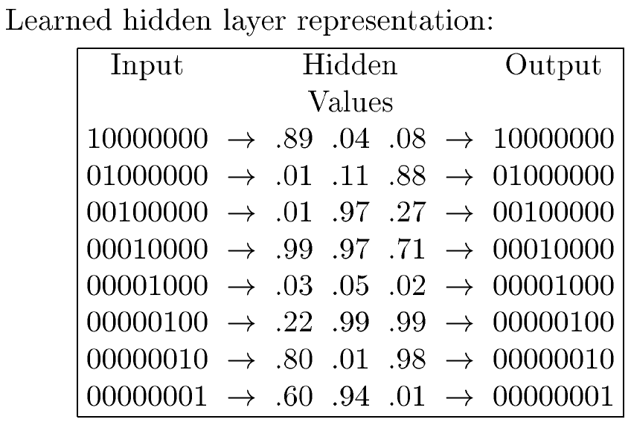
Learning Representation – Autoencoder
The hidden layer is where the network stores it’s internal abstract representation of the training data
100
001
010
111
000
011
101
110

Slide 13
Deep Network
Multi layers
The problem with large networks trained by backpropagation
  Vanishing gradients
    As errors propagate from layer to layer, they shrink exponentially with the number of layers.
      As information is passed back, the gradients begin to vanish and become small relative to the weights of the networks.
  Overfitting
    fitting the training data too closely, maybe with hypotheses that are too complex. Will perform much more poorly on real examples.

Slide 14
Deep Network
Layer-by-layer training
  Deep networks can be trained greedily, one layer at a time, to help to overcome the vanishing gradient and overfitting problems associated with classic backpropagation.
  Pre-training
Can then apply fine-tuning

Slide 15
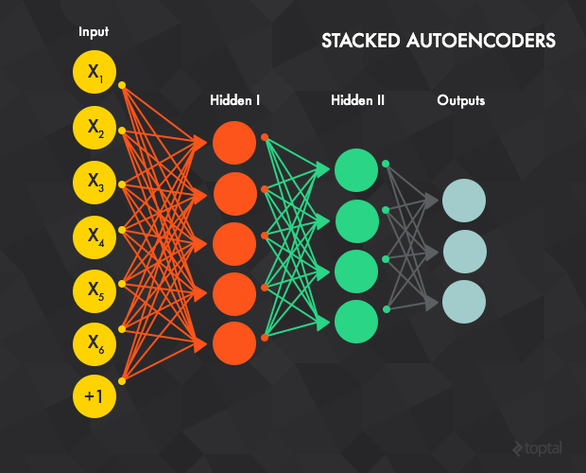
Stacked Autoencoder
The network consists of multiple stacked autoencoders
  The hidden layer of autoencoder t acts as an input layer to autoencoder t + 1.

Slide 16
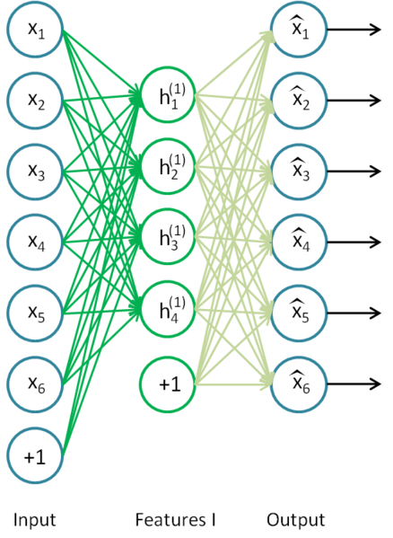
Training Stacked Autoencoder
Greedy layer-wise training
  Train the first autoencoder individually using the backpropagation method with all available training data.

Slide 17
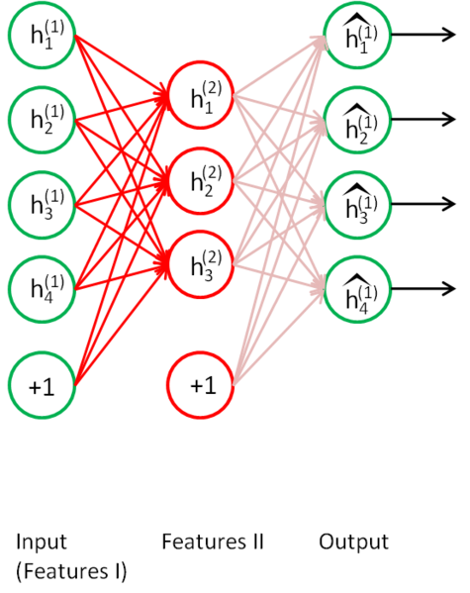
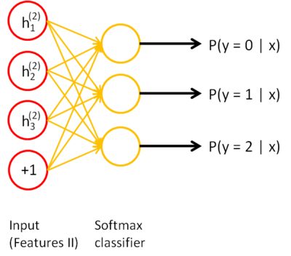
  Train the second autoencoder
    Clamping an input sample to the first autoencoder, and propagated forward to the second layer. Next, the weights of second layer are updated using backpropagation.
    Uses all the training samples
  Repeat the previous procedure for all the layers

Slide 18
Training Stacked Autoencoder
Fine-tuning
  Add one or more fully connected layer(s) to the last layer.
  The whole network can now be viewed as a multilayer perceptron and is trained using backpropagation.
  Or, the output of stacked autoencoder might be used as the input to a supervised learning algorithm

Slide 19
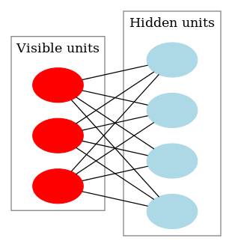
Restricted Boltzmann Machine (RBM)
A generative stochastic neural network that can learn a probability distribution over its set of inputs
Two levels
  "visible" and "hidden"
There are no hidden-hidden or visible-visible connections.
Connections are undirected
The standard RBM has binary hidden and visible units: that is, the unit activation is 0 or 1

Slide 20

Training RBM
Contrastive divergence (CD)
Positive phase
  An input sample v is clamped to the input layer
  v is propagated to the hidden layer in a similar manner to the feedforward networks.
    Compute the probabilities of the hidden units and sample a hidden activation vector h from this probability distribution.
      σ is sigmoid function and b_{j} is the bias of h_{j}

Slide 21

Training RBM
Negative phase
  Propagate h back to the visible layer,
    Compute the probabilities of the hidden units , and sample a reconstruction v' of the visible units
  Then Propagate the new v’ back to the hidden layer , resample the hidden activations h' from v’
Weight update
      a is the learning rate

Slide 22
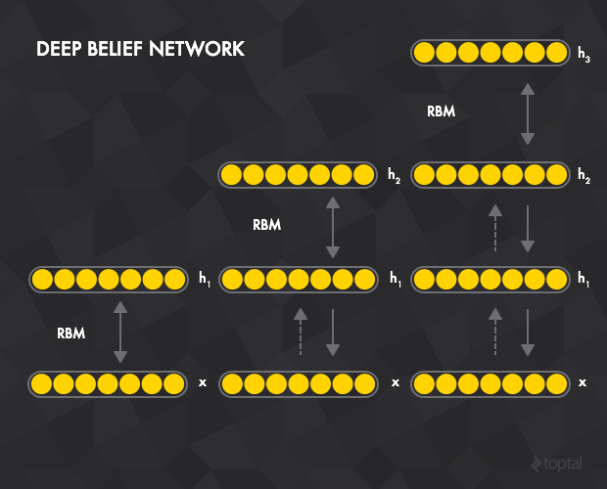
Deep Belief Networks
Stack restricted Boltzmann machines
  The hidden layer of RBM t acts as a visible layer for RBM t+1.

Slide 23
Training Deep Belief Networks
Train the first RBM t=1 using contrastive divergence with all the training samples.
Train the second RBM t=2.
  Clamping the input sample to the visible layer of t=1, which is propagated forward to the hidden layer of t=1. This data then serves to initiate contrastive divergence training for t=2.
Repeat the previous procedure for all the layers.
Similar to the stacked autoencoders, after pre-training the network can be extended by connecting one or more fully connected layers to the final RBM hidden layer. This forms a multi-layer perceptron which can then be fine tuned using backpropagation.

